Slide 1
Lecture 6:
2.2. Ancient Empires: “Efflorescences” and Falls
Brad DeLong
Department of Economics and Blum Center, U.C. Berkeley, & WCEG
last revised: 2020-02-06
for presentation: 2020-02-11
Original course by Melissa Dell (Harvard Econ 1342), revised by Brad DeLong, research assistance by Anish Biligiri
<https://github.com/braddelong/public-files/blob/master/econ-135-lecture-6.pptx>

Slide 2
Roadmap for the Next Week
6. Civilizational "Efflorescences" and Imperial Declines (Feb 11):
Read Before: Willem M. Jongman (2007): Gibbon was Right: The Decline and Fall of the Roman Economy <https://delong.typepad.com/jongman-gibbon-was-right.pdf>
Read Before: Peter Temin: The Roman Market Economy, Roman Growth <https://delong.typepad.com/files/temin-roman-growth.pdf>
Slides: <https://github.com/braddelong/public-files/blob/master/econ-135-lecture-6.pptx>
Finish: Assignment 4: Malthusian economies paper; due Feb 12
7. Why Was Pre-Industrial Progress so Slow on Average? (Feb 13):
Read Before: Josh Ober (2019): Agamemnon's Cluelessness, selections <https://delong.typepad.com/files/ober-agamemnon-selections.pdf>
Read Before: Moses Finley: Technical Innovation and Economic Progress in the Ancient World <https://delong.typepad.com/finley-technical.pdf>
Slides: <https://github.com/braddelong/public-files/blob/master/econ-135-lecture-7.pptx>
Start: Assignment 5: Simulations with the Solow growth model; due Feb 19 <https://bcourses.berkeley.edu/courses/1487685/assignments/8065916>
8. Commercial Revolutions (Feb 18):
Read: Christopher Berry (2018): Adam Smith: A Very Short Introduction <https://delong.typepad.com/files/berry-smith.pdf>
Slides: <https://github.com/braddelong/public-files/blob/master/econ-135-lecture-8.pptx>
Finish: Assignment 5: Simulations with the Solow growth model; due Feb 19 <https://bcourses.berkeley.edu/courses/1487685/assignments/8065916>

Slide 3
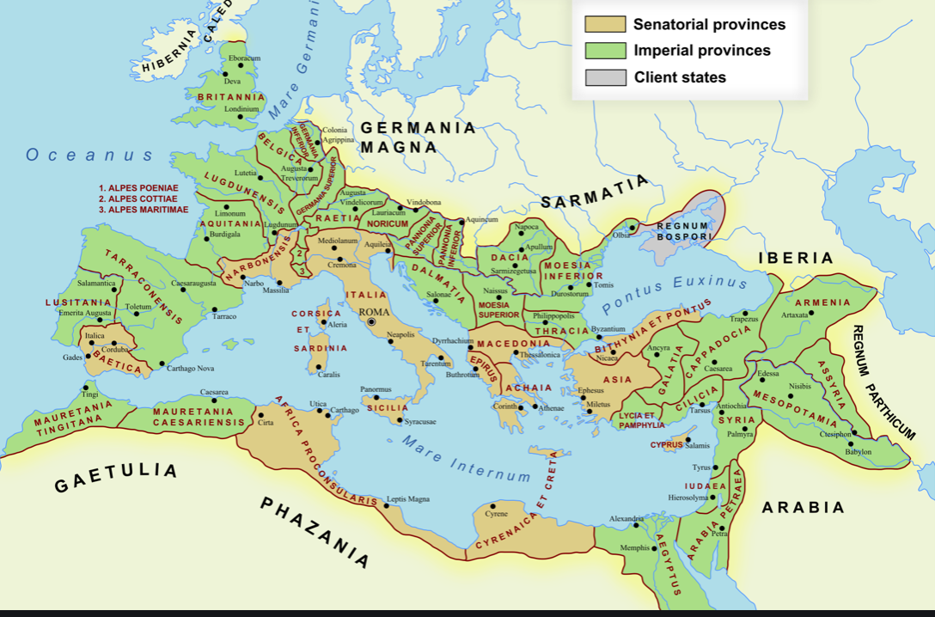
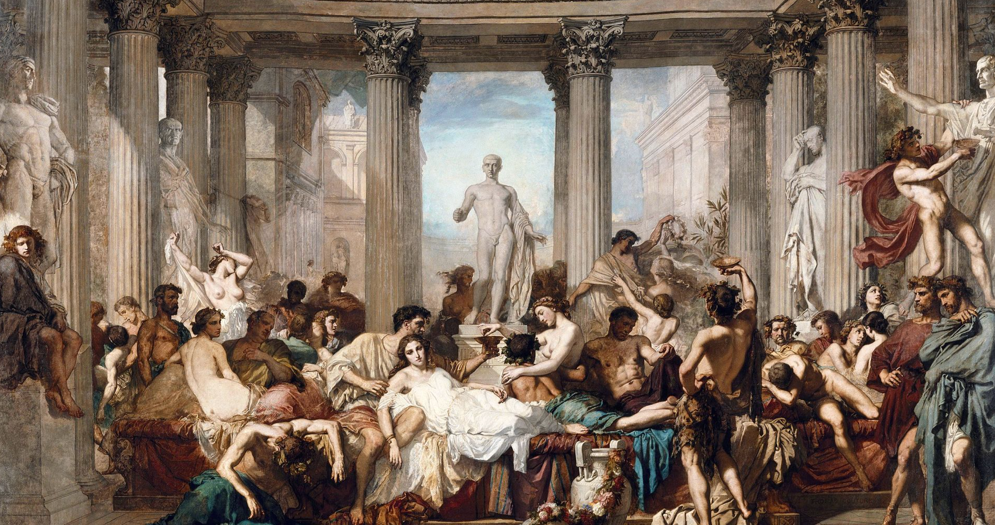
Preview: Lecture 6: Ancient Empires
What I am going to cover:
“Efflorescences”: prosperity in classical Greece and Rome
The rise of the Roman Empire
Review something…
The fall of the Roman Empire
What’s going to be on the exam?
What are the key takeaways?

Slide 4


Pre-Industrial “Efflorescences” (and Declines)
Ideas courtesy of Jack Goldsmith, Daron Acemoglu and James Robinson:
The Malthusian model misses a great deal of the interesting action prior to the Industrial Revolution.
An alternative explanation for why there was no long-run trend in living standards is the theory of ‘efflorescence and decline’
I organize my thoughts about this with the two Malthusian equations, and with their bunch of variables and parameters: h, γ, β, φ, y^{sub}, s, δ, θ, and H that together determine y^{*mal} and L^{*mal}
This is best thought of as a filing system for factors that may be important—given the importance of both capital and labor efficiency, the roles of ideas and of resources in producing labor efficiency, and Malthusian population dynamics, these are the things you should look at

Slide 5
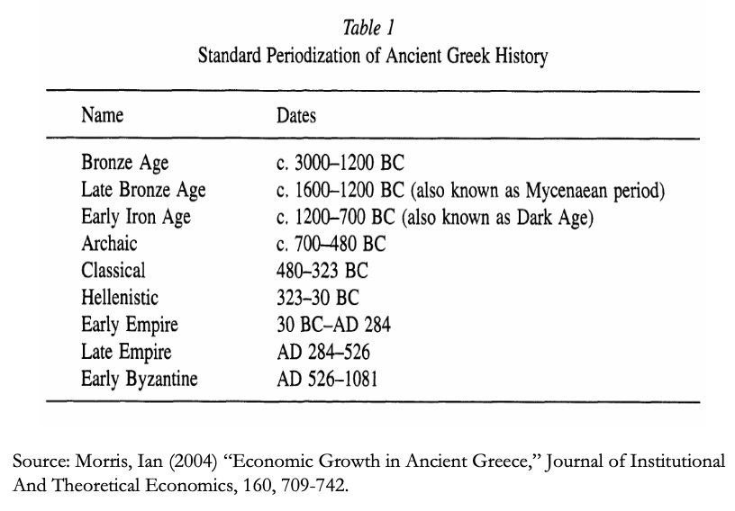
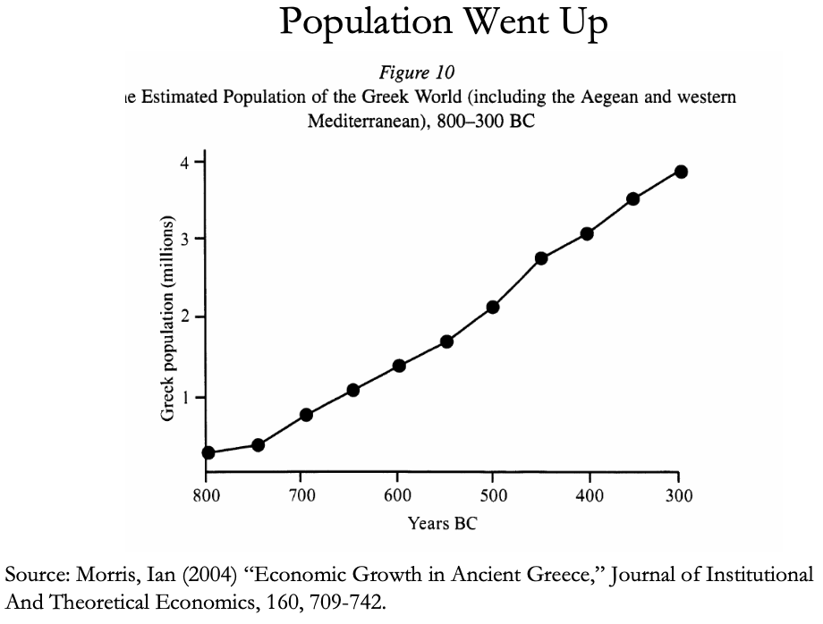
The Classical Greek Efflorescence
Emerging out of the Iron Dark Age of -1200 to -800:
When the Greek city states emerged they did so with functional systems of governance which provided public goods, such as security for trade and investment.
This initiated a period of sustained increases in living standards.
While Ancient Greece did have a period of democracy, it was relative short (less than 200 years) compared to the duration of the polity and most citizens - slaves, poor citizens who couldn’t afford their tax bill, women - could not participate.
Greek institutions (rules according to which the society was organized) tended to be “extractive.” For example, the economy was largely based upon slavery.
Slide taken from Melissa Dell

Slide 6
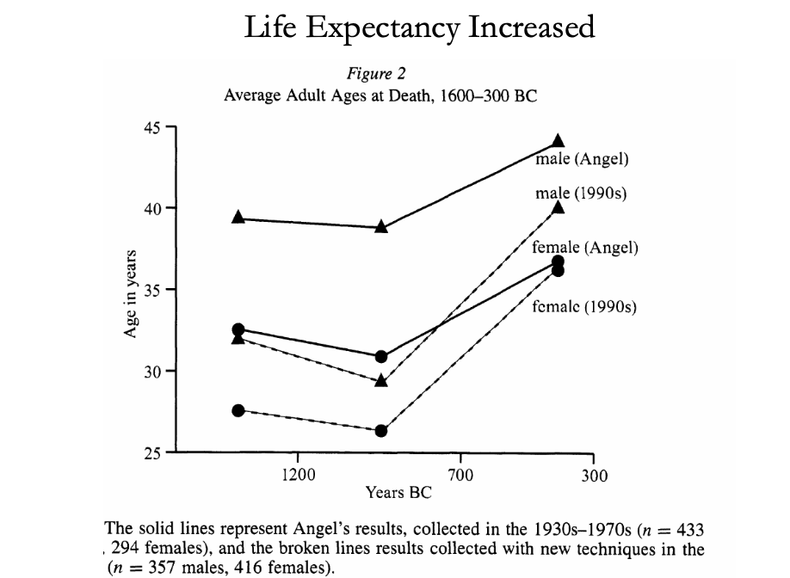
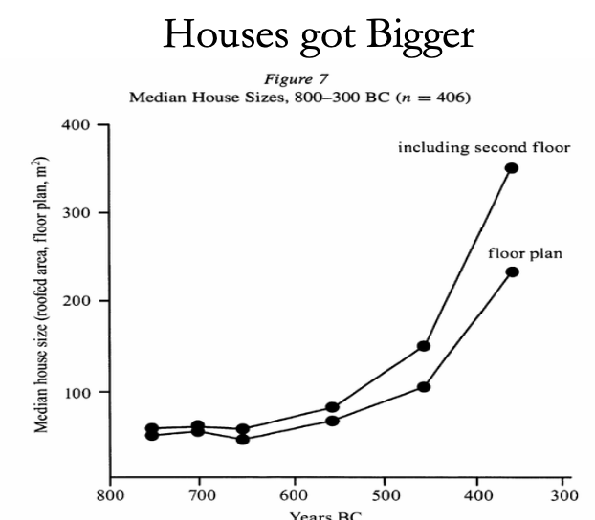
The Classical Greek Efflorescence II
“Developmental” or “Extractive”?
Extractive political institutions concentrate political power in the hands of some group who can use that power to redistribute wealth and income to themselves. This resulting concentration of wealth tends to reinforce the initial set of political institutions.
Roving bandits or stationary bandits?
Acemoglu and Robinson hypothesize that growth was not sustained in ancient societies because their institutions were extractive, and extractive institutions are incompatible with sustaining growth in the long run.
They argue that this is because extracting resources creates conflicts over who will control those resources, and it may also induce rebellion from below.
In either case political instability can bring the government and economy down.
Slide taken from Melissa Dell

Slide 7
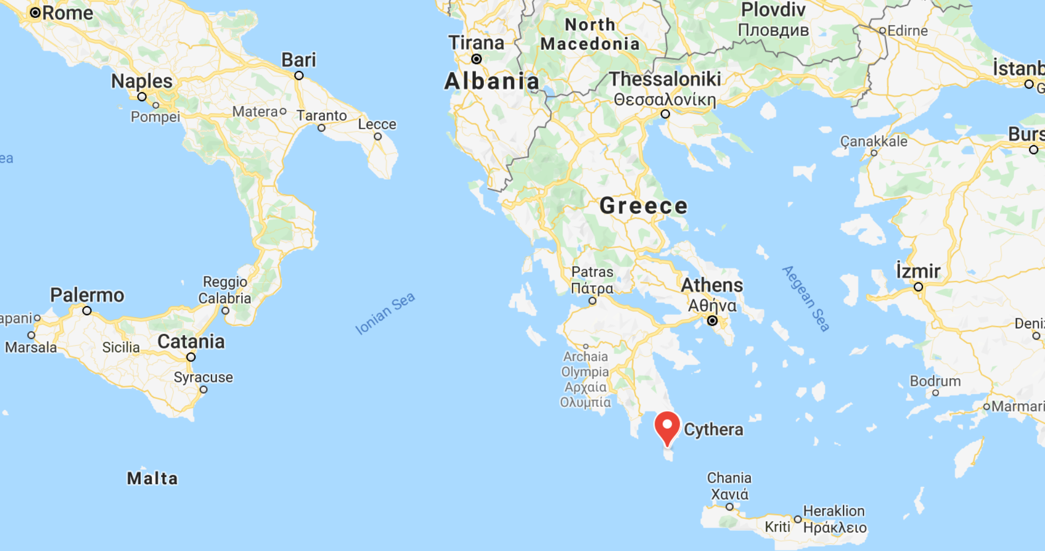
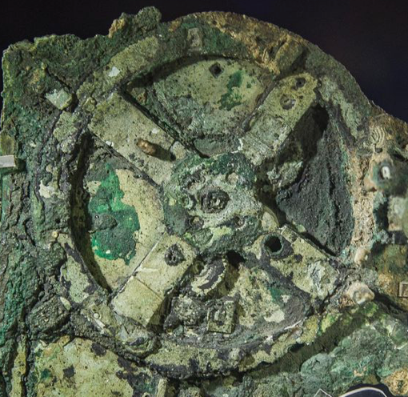
The Anti-Kythera Mechanism
What is this?
Built between -150 and -70. Rhodes13” x 7” x 4“ wooden box
Gears—largest 5” in diameter
Inscriptions
Wikipedia: “37 gear wheels enabling it to follow the movements of the Moon and the Sun through the zodiac, to predict eclipses and even to model the irregular orbit of the Moon, where the Moon's velocity is higher in its perigee than in its apogee. This motion was studied in the 2nd century BC by astronomer Hipparchus of Rhodes, and it is speculated that he may have been consulted in the machine's construction. The knowledge of this technology was lost at some point in antiquity. Similar technological works later appeared in the medieval Byzantine and Islamic worlds, but works with similar complexity did not appear again until the development of mechanical astronomical clocks in Europe in the fourteenth century…”

Slide 8
The Anti-Kythera Mechanism II
What is this?
Brian Resnick: “A main gear would move to represent the calendar year, and would, in turn, move many separate smaller gears to represent the motions of the planets, sun, and moon. So you could set the main gear to the calendar date and get approximations for where those celestial objects would be in the sky on that date…. You, as a user, could input a few simple variables and it would yield a flurry of complicated mathematical calculations.… All the user had to do was enter the main date on one gear, and through a series of subsequent gear turns, the mechanism could calculate things like the angle of the sun crossing the sky. (For some reference, mechanical calculators—which used gear ratios to add and subtract—didn’t arrive in Europe until the 1600s)…”

Slide 9
Cicero (-54): De Re Publica
“With the exception of the dream of Scipio, in the last book, the whole treatise was lost till the year 1822, when the librarian of the Vatican discovered a portion of them among the palimpsests in that library. What he discovered is translated here; but it is in a most imperfect and mutilated state. The form selected was that of a dialogue, in imitation of those of Plato…”
I.XIV:
Then Philus said: “I am not about to bring you anything new, or anything which has been thought over or discovered by me myself. But I recollect that Caius Sulpicius Gallus, who was a man of profound learning, as you are aware, when this same thing was reported to have taken place in his time, while he was staying in the house of Marcus Marcellus, who had been his colleague in the consulship, asked to see a celestial globe which Marcellus’s grandfather had saved after the capture of Syracuse from that magnificent and opulent city, without bringing to his own home any other memorial out of so great a booty; which I had often heard mentioned on account of the great fame of Archimedes; but its appearance, however, did not seem to me particularly striking. For that other is more elegant in form, and more generally known, which was made by the same Archimedes, and deposited by the same Marcellus in the Temple of Virtue at Rome.
“But as soon as Gallus had begun to explain, in a most scientific manner, the principle of this machine, I felt that the Sicilian geometrician must have possessed a genius superior to anything we usually conceive to belong to our nature. For Gallus assured us that that other solid and compact globe was a very ancient invention, and that the first model had been originally made by Thales of Miletus. That afterward Eudoxus of Cnidus, a disciple of Plato, had traced on its surface the stars that appear in the sky, and that many years subsequently, borrowing from Eudoxus this beautiful design and representation, Aratus had illustrated it in his verses, not by any science of astronomy, but by the ornament of poetic description. He added that the figure of the globe, which displayed the motions of the sun and moon, and the five planets, or wandering stars, could not be represented by the primitive solid globe; and that in this the invention of Archimedes was admirable, because he had calculated how a single revolution should maintain unequal and diversified progressions in dissimilar motions.
“In fact, when Gallus moved this globe, we observed that the moon succeeded the sun by as many turns of the wheel in the machine as days in the heavens. From whence it resulted that the progress of the sun was marked as in the heavens, and that the moon touched the point where she is obscured by the earth’s shadow at the instant the sun appears opposite….
Scipio: “I had myself a great affection for this Gallus, and I know that he was very much beloved and esteemed by my father Paulus. I recollect that when I was very young, when my father, as consul, commanded in Macedonia, and we were in the camp, our army was seized with a pious terror, because suddenly, in a clear night, the bright and full moon became eclipsed. And Gallus, who was then our lieutenant, the year before that in which he was elected consul, hesitated not, next morning, to state in the camp that it was no prodigy, and that the phenomenon which had then appeared would always appear at certain periods, when the sun was so placed that he could not affect the moon with his light…”

Slide 10
The Rise of Rome
Roman Institutions are key to the rise of Rome:
In 510BC, the citizens of Rome overthrew their king, Lucius Tarquinius Superbus, and created a republic.
The state was run by elected officials:
Two consuls who had the job for one year
Other magistrates: praetors, aediles, proconsuls
Tribunes.
Offices were elected, annual, and held by multiple people at the same time
This greatly reduced the ability of any one person to consolidate or exploit his power.
The institutions of the Republic contained a system of checks and balances which distributed power fairly widely.
Even if elite patrician families had far more power, it was possible for non-elites, so called plebeians, to get to the top, and they constrained the power of the elites.
Then some plebeian families become equally elite…
The nobiles
Roman assemblies:
Centuriate: 193 centuries on the basis of military organization, weighted toward the rich. Elects the magistrates, declares war and peace
Tribal: After 241 BC, 35 tribes on the basis of geographical location
Plebeian: Non-patricians, run by Tribunes
Senate
Roman institutions:
Legions
Phalanx
Manipular
Marian
Imperium
Provinciae
Proconsuls and propraetors
Slide taken from Melissa Dell

Slide 11
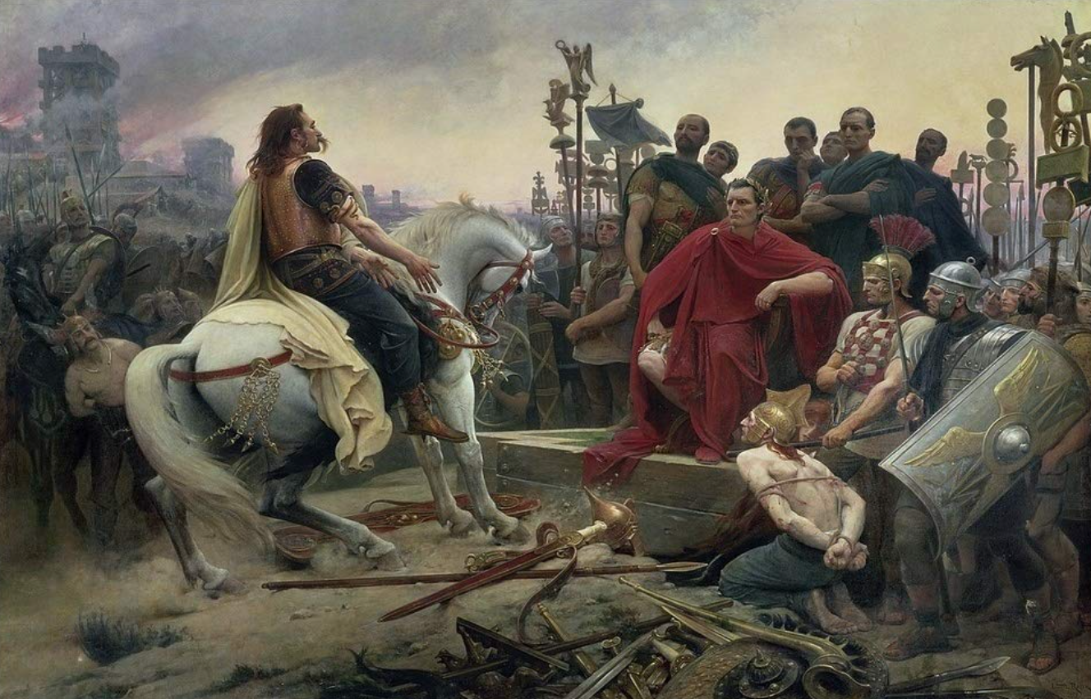
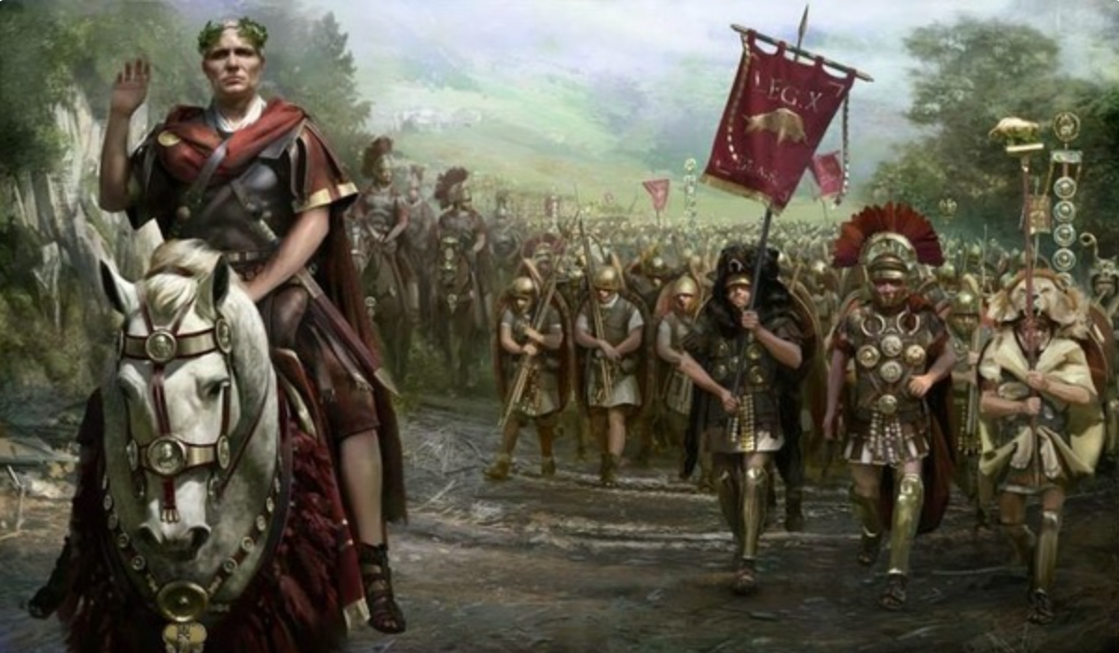
The Rise of Rome II
Roman Institutions are key to the rise of Rome:
Four key factors:
Militarism (on the part of elites competing for authority)
Mobilization (of the citizen mass)
Widely shared benefits (of conquest)
Incorporation (of conquered communities)
Mammoth military and political expansion after -340, and substantial economic, expansion
Slide taken from Melissa Dell

Slide 12
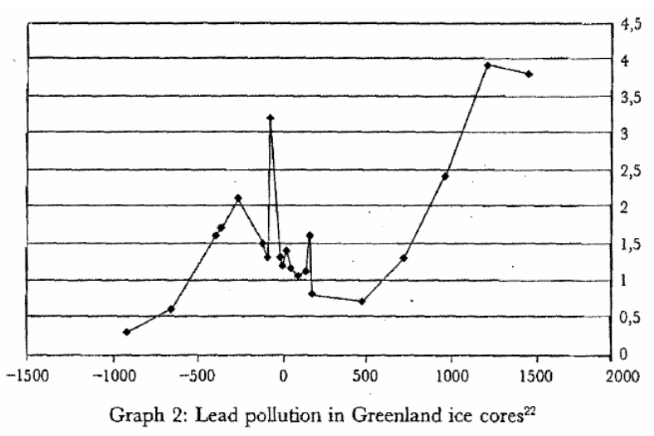
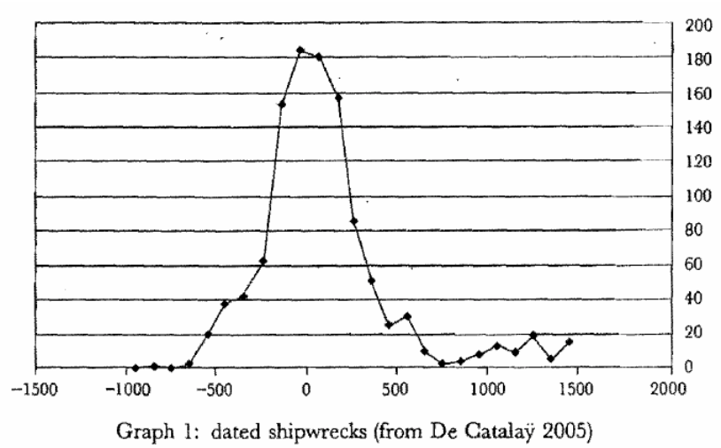
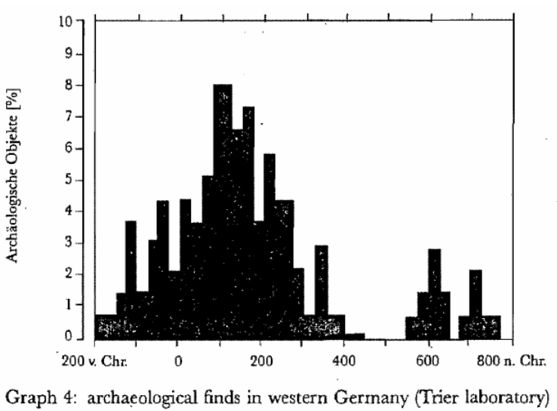
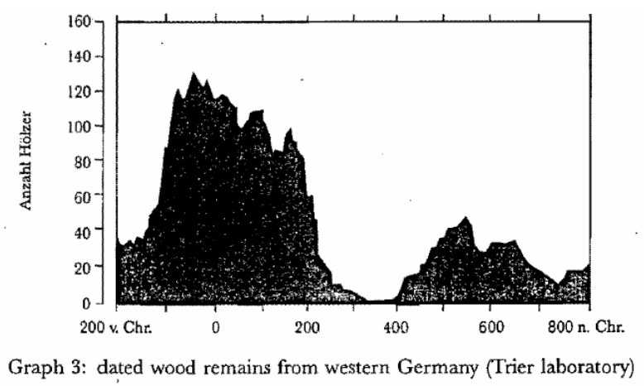

Measuring Roman Efflorescence
There are many interesting ways to track economic expansion:
Shipwrecks indicate trade, but they also track the movement of goods by fiat. For example, the citizens of Rome were kept happy by the free distribution of bread after 58BC. This was later extended to olive oil and even wine. This had to be shipped (mostly from Egypt and North Africa).
The Romans also moved around taxes levied in the provinces and supplied their troops. Some argue that 2/3 of all the ‘trade’ was actually the state moving stuff around.
For Roman citizens, economic institutions were quite good. However, the Italian economy was based on slavery (about 35% of the population of Italy were slaves at the time of the Emperor Augustus). There was little technological change.
Slide taken from Melissa Dell

Slide 13
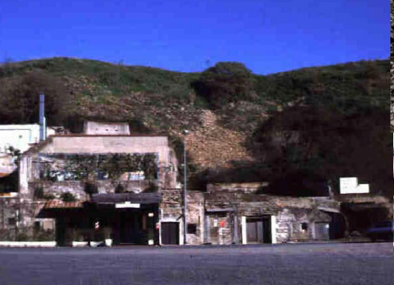
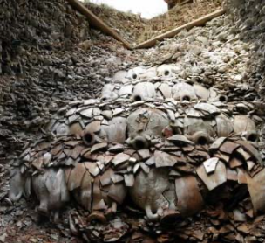
Pottery Mountain in Rome
53 million broken amphorae
Slide taken from Melissa Dell

Slide 14
Republic to Empire
Political transition:
The expansion of Rome’s conquests created inequality and increasing political instability.
There were calls for the redistribution of land and power.
For example, Plebeian Tribune Tiberius Gracchus started to develop very ‘populist’ political platforms which threatened the senatorial elites.
The culmination of this was civil war, the dictatorship of Julius Caesar, and finally the creation of the Empire under Augustus.
First the principate
Then the dominate
Augustus reformed the army, removing it as a bastion of plebeian power.
His successor Tiberius stripped the assemblies of powers and gave them to the senate—and then neutered the senate
A semi-hereditary monarchy replaced the Republic:
“May good success attend the Roman senate and people and myself. I hereby adopt as my son Marcus Ulpius Nerva Traianus…”
This was a move towards more “extractive” political institutions and though it stabilized things for awhile, there was an eventual movement towards even more extractive economic institutions
Slide taken from Melissa Dell

Slide 15
Always Scribble, Scribble, Scribble! Eh! Mr. Gibbon?
Beste, Memorials:
The Duke of Gloucester, brother of King George III, permitted Mr. Gibbon to present to him the first volume of The History of the Decline and Fall of the Roman Empire. When the second volume of that work appeared, it was quite in order that it should be presented to His Royal Highness in like manner. The prince received the author with much good nature and affability, saying to him, as he laid the quarto on the table,
“Another damned thick, square book! Always, scribble, scribble, scribble! Eh! Mr. Gibbon?”

Slide 16
Always Scribble, Scribble, Scribble! Eh! Mr. Gibbon?
Five Good Emperors: Nerva-Trajan-Hadrian-Antonius Pius-Marcus Aurelius:
If a man were called to fix the period in the history of the world, during which the condition of the human race was most happy and prosperous, he would, without hesitation, name that which elapsed from the death of Domitian to the accession of Commodus.
The vast extent of the Roman empire was governed by absolute power, under the guidance of virtue and wisdom.
The armies were restrained by the firm but gentle hand of four successive emperors, whose characters and authority commanded involuntary respect.
The forms of the civil administration were carefully preserved by Nerva, Trajan, Hadrian, and the Antonines, who delighted in the image of liberty, and were pleased with considering themselves as the accountable ministers of the laws.
Such princes deserved the honor of restoring the republic, had the Romans of their days been capable of enjoying a rational freedom.
The labors of these monarchs were overpaid by
the immense reward that inseparably waited on their success;
by the honest pride of virtue, and
by the exquisite delight of beholding the general happiness of which they were the authors.

Slide 17
Aelius Aristides
The Roman Oration:
Whatever the seasons make grow and whatever countries and rivers and lakes and arts of Hellenes and non-Hellenes produce are brought from every land and sea, so that if one would look at all these things, he must needs behold them either by visiting the entire civilized world or by coming to this city. For whatever is grown and made among each people cannot fail to be here at all times and in abundance. And here the the merchant vessels come carrying these many products from all region in every season and even at every equinox, so that the city appears a kind of common emporium of the world.
Cargoes from India and, if you will, even from Arabia the Blest one can see in such numbers as to surmise that in those lands the trees will have been stripped bare and that the inhabitants of these lands, if they need anything, must come here and beg for a share of their own. Again one can see Babylonian garments and ornaments from the barbarian country beyond arriving in greater quantity and with more ease than if shippers from Naxos or from Cythnos, bearing something from those islands, had but to enter the port of Athens. Your farms are Egypt, Sicily and the civilized part of Africa.
Arrivals and departures by sea never cease, so that the wonder is not that the harbor has insufficient space for merchant vessels, but that even the sea has enough, if it really does.
And just as Hesiod said about the ends of the Ocean, that there is a common channel where all waters have one source and destination, so there is a common channel to Rome and all meet here, trade, shipping, agriculture, metallurgy, all the arts and crafts that are or ever have been, all the things that are engendered or or grow from the earth. And whatever one does not see here neither did nor does exist. And so it is not easy to which is greater, the superiority of this city in respect to the cities that now are or the superiority of this city respect to the empires that ever were…

Slide 18
Three Great Plagues
But the demands of the empire for revenue and of the upper class for resources remain the same:
Antonine Plague (smallpox?): Antonine ⇒ Severian dynasty
Plague of St. Cyrian (Ebola-like?): Things fall completely apart, then Diocletian: between Philip the Arab and Diocletian, 18 emperors in 35 years, plus two breakaways; 12 of the 18 were assassinated
Plague of Justinian (Bubonic): Flavius Apion…

Slide 19
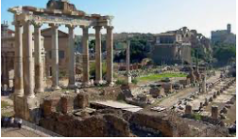
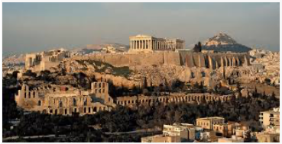
Big Ideas: Lecture 6: Ancient Empires
Takeaways from this lecture:
OK: What should the takeaways from this lecture be?

Slide 20
Catch Our Breath…
Ask a couple of questions?
Make a couple of comments?
Any more readings to recommend?

Slide 21
Notes

